Slide 1

The Process Concept
PASS: nice work, Parth. Thorough and insightful.
CS532: OS Foundations
Lab Assignment
email address: parth2@pdx.edu
partner’s email address: N/A

Slide 2
Instructions: Make a copy of this document, move your copy to your submissions folder and fill the document with your responses. Use the space on each slide to show your responses, and add additional slides as needed.
When ready for grading: complete the lab assignment submission form and include a link to your filled document

Slide 3
Get the OSTEP Simulators
For this lab assignment and several subsequent assignments you will utilize simulators provided by the authors of the OSTEP book. These simulators allow you to study infinite OS scenarios without the tedious, time-consuming work of configuring and measuring real operating systems.
To obtain all of the simulators, login to linux.cs.pdx.edu and clone the corresponding git repository. Do it like this:
git clone https://github.com/remzi-arpacidusseau/ostep-homework/

Slide 4
process-run.py
The process-run.py simulator helps us to understand process scheduling scenarios. To use it, cd into your new ostep-homework directory and then cd into the cpu-intro sub-directory. Read the Readme.md file contained in the cpu-intro directory. Read this file thoroughly and try every step shown there. Going through the Readme.md file thoroughly will give you a strong understanding of not only this simulator but also many of the simulators used for other lab assignments in this class.

Slide 5
1. Run process-run.py with the following flags: -l 5:100,5:100.
What should the CPU utilization be (e.g., the percent of time the CPU is in use?)
Explain your reasoning.
Answer in next 3 slides.

Slide 6
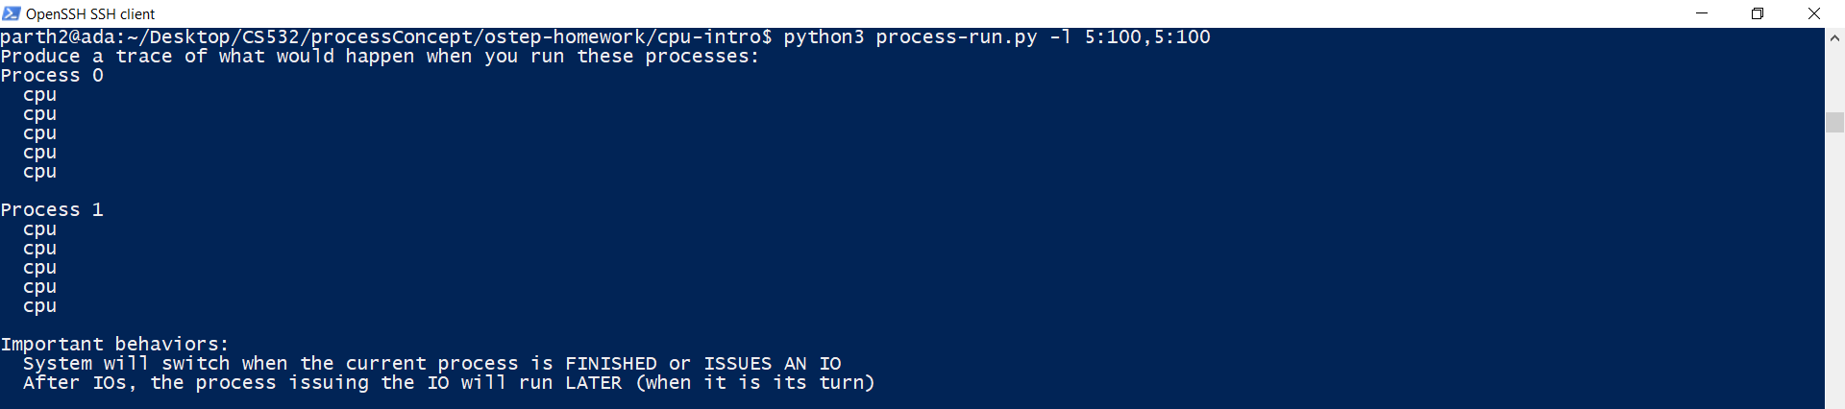
Screenshot depicting the command run and it’s result

Slide 7
The command used for running the process with the specified parameters is:-
python3 process-run.py -l 5:100,5:100
From the command alone, we can see that the CPU Utilization would be 100% for both the processes.
This is because in the command written, we are specifying that for the process 1 (PID:0), number of instructions that would be run is 5 and the chances that the CPU will run those instructions of process 1 is 100%.
Similarly, for process 2 (PID:1), the number of instructions that would be run is 5 and the chances that the CPU will run those instructions for process 2 is also 100%.
This means that then process 1 is initiated, it will have CPU resources all the time till it finishes. Also, since there is no interrupt parameter set by us in the command, the utilization of CPU would be 100%.
Till the time the CPU is running process 1, process 2 will be in READY state waiting for CPU resources to be free so that it can run in the CPU.
When Process 1 (PID:0) enters the DONE/Completed state, Process 2(PID:1) will start utilizing CPU resources at 100% capacity.
This means that CPU utilization is 100% and IO utilization is 0.
This can also be confirmed by the screenshot of the command
python3 process-run.py -l 5:100,5:100 -c and python3 process-run.py -l 5:100,5:100 -cp in the next slide where we have computed the completed statistics for the processes using “-c” and “-p” tags.

Slide 8
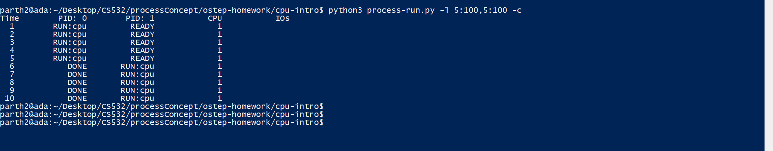
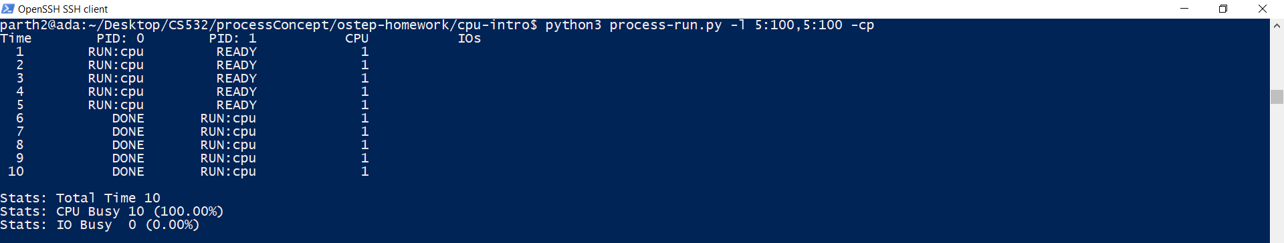

Slide 9
2. Now run with these flags: ./process-run.py -l 4:100,1:0. These flags specify one process with 4 instructions (all to use the CPU), and one that simply issues an I/O and waits for it to be done.
How long does it take to complete both processes?
Answer in next 2 slides

Slide 10
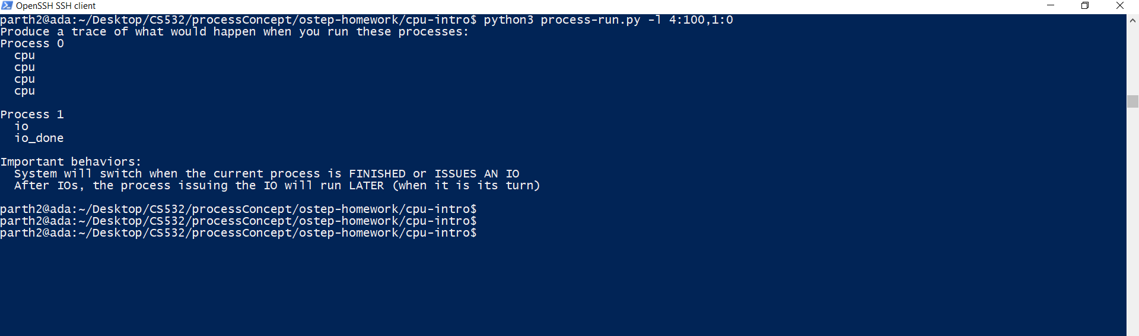
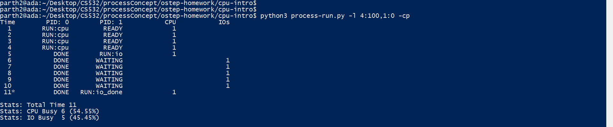

Slide 11
As we can see from the screenshot in the previous 2 slides having screenshots of the statistics, we can say that the time taken by the CPU to complete both the processes is 11 clock ticks where the CPU was busy for 6 clock ticks (54.55%) and the IO was busy for 5 clock ticks(45.45%).
So,
Total ticks = CPU busy Ticks (pid:1 (I/O Process) in READY) + I/O Busy Ticks (pid:0 (CPU Heavy) process DONE)
Total Ticks = 5+6
Total Ticks = 11

Slide 12
3. Switch the order of the processes: -l 1:0,4:100.
What happens now?
Does switching the order matter?
Why?
Answer in the next 3 slides

Slide 13
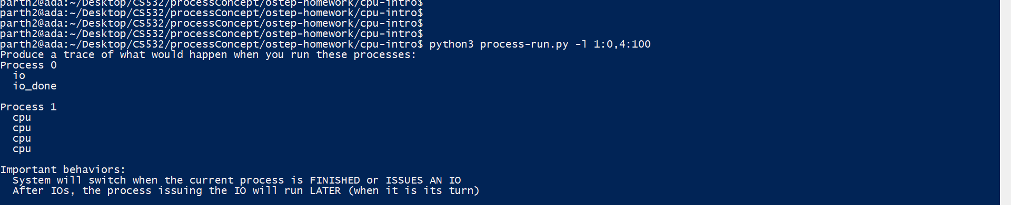

Slide 14
Yes, the order of Processes written in the command matters. This can be explained as below:-
When we process the order of the processes, then the runtime reduces from 11 clock ticks from the previous question to 7 clock ticks.
This is because when we switch the order of the processes, then the process with I/O runs first.
Now when the Process with I/O runs first, It goes from RUNNING State to WAITING state and starts waiting for the I/O to be completed.
During this WAITING time period, the CPU starts executing the second Process where there is no I/O interrupt. The second process completes in about 5 clock ticks after which, the first process which was in WAITING state now is pushed through the process queue to the RUNNING state again where it is executed again and completes its functionality.
The first process will then go to the DONE/completed state.
Due to this, the total time decreases from 11 clock ticks to 7 clock ticks.
This can be seen from the two screenshots pasted in the previous and next slide as well.
The command used to run the process is:- python3 process-run.py -l 1:0,4:100. (Previous slide)
The command used to run the process with statistics is:- python3 process-run.py -l 1:0,4:100 -cp (next slide)

Slide 15
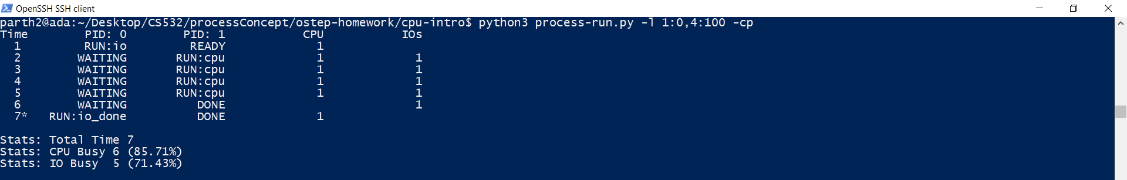

Slide 16
4. We’ll now explore some of the other flags. One important flag is -S, which determines how the system reacts when a process issues an I/O. With the flag set to SWITCH_ON_END, the system will NOT switch to another process while one is doing I/O, instead waiting until the process is completely finished.
What happens when you run the following two processes (-l 1:0,4:100 -S SWITCH_ON_END), one doing I/O and the other doing CPU work?
Answer in next 3 slides

Slide 17
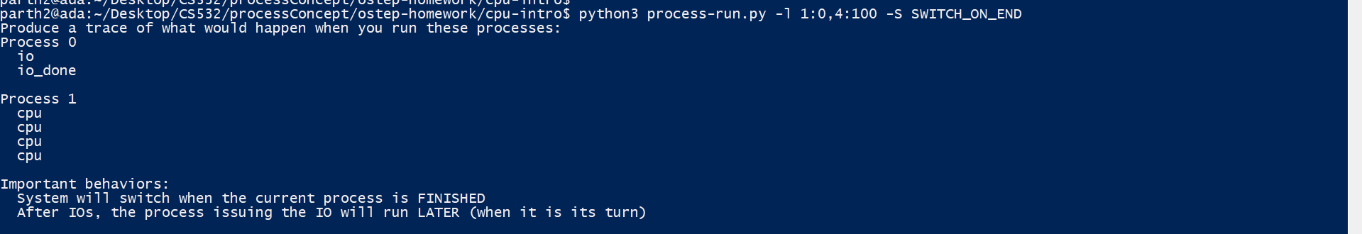

Slide 18
When we will use -S SWITCH_ON_END along with the process list <1:0,4:100>, then, the SWITCH_ON_END will not allow the process-2 (CPU execution heavy) to run when process-1 is in waiting state. The CPU will keep on waiting for the process-1 (which is in the WAITING state) to complete its execution before handing the CPU resources to the second process which will then run.
Hence, For the first 7 clock ticks, the process-2 will remain in the READY state, and then after the process-1 completes its execution (RUNNING+WAITING+DONE states) in those 7 clock ticks, process-2 will be executed (READY to RUNNING to DONE state).
All this process will take more time and will be equal to 11 clock ticks (same as the second Question of this lab assignment).
Total time taken = 11 clock ticks.
This can be verified from the next two screenshots whose commands are given below:-
python3 process-run.py -l 1:0,4:100 -S SWITCH_ON_END -c
python3 process-run.py -l 1:0,4:100 -S SWITCH_ON_END -cp

Slide 19
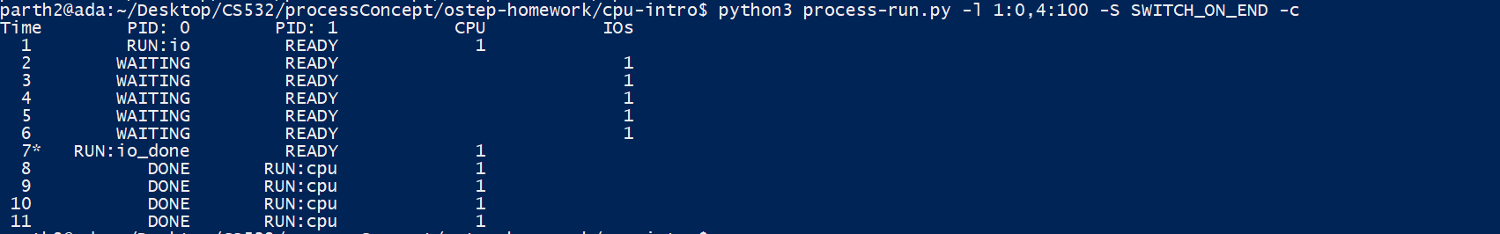
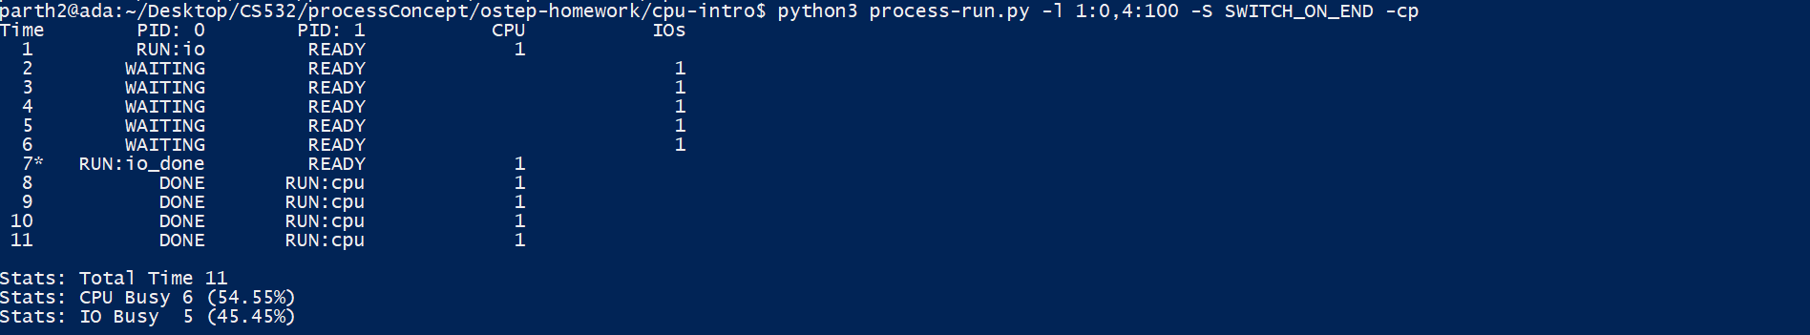

Slide 20
5. Now, run the same processes, but with the switching behavior set to switch to another process whenever one is WAITING for I/O
-l 1:0,4:100 -c -S SWITCH_ON_IO
What happens now?

Slide 21
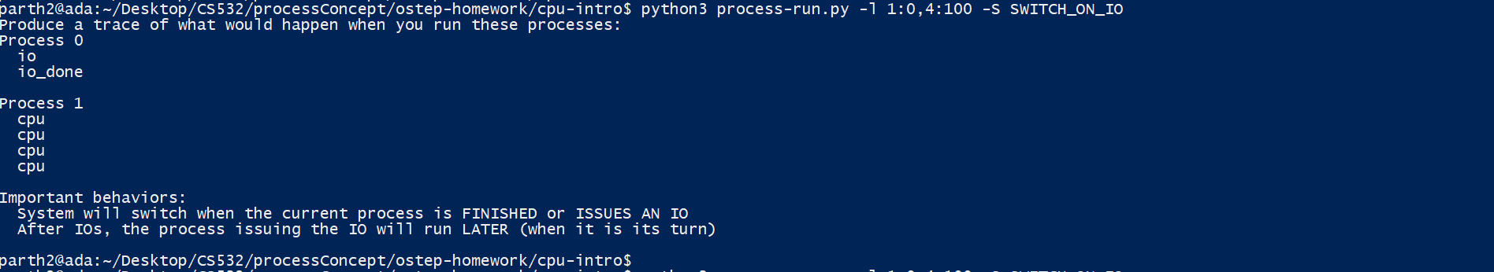

Slide 22
When we change the -S component to SWITCH_ON_IO for the same processes as mentioned in the previous question, then the process with IO runs first. (PID:0)
It is sent to CPU for being executed where it starts executing when due to I/O nature of it, it is transferred to the WAITING state.
During this time other process with no I/O(PID:1) is in READY state.
When process-1 with I/O enters(pid:0) the WAITING State, the CPU allocates its resources to the Process-2(pid:1) which changes its state from READY to RUNNING. This is because we have explicitly mentioned in the command - SWITCH_ON_IO i.e. (switch to another process whenever one is WAITING for I/O)
Now, after the Process-2(pid:1) is completely executed, then the process- (pid:0) enters the RUNNING state from WAITING state after completing its I/O part of execution.
Process-1(pid:0) is then completed as well.
This all takes 7 clock ticks as given in the screenshots in the next slide.
Commands used are:-
python3 process-run.py -l 1:0,4:100 -S SWITCH_ON_IO -c
python3 process-run.py -l 1:0,4:100 -S SWITCH_ON_IO -cp

Slide 23
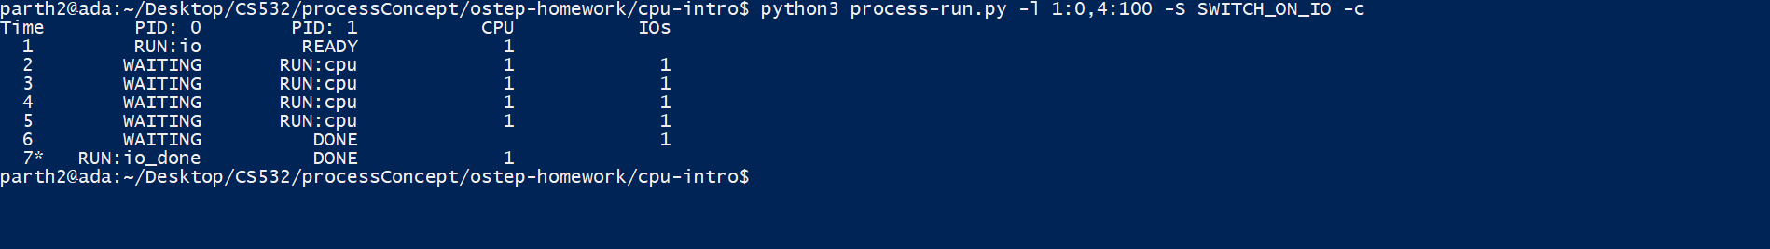
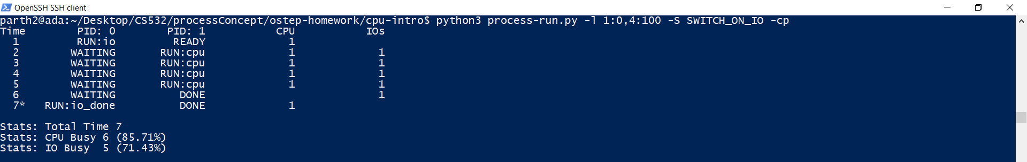

Slide 24
6. One other important behavior is what to do when an I/O completes. With -I IO_RUN_LATER, when an I/O completes, the process that issued it is not necessarily run right away; rather, whatever was running at the time keeps running.
Try these parameters:
-l 3:0,5:100,5:100,5:100 -S SWITCH_ON_IO -I IO_RUN_LATER
Are system resources being effectively utilized?

Slide 25
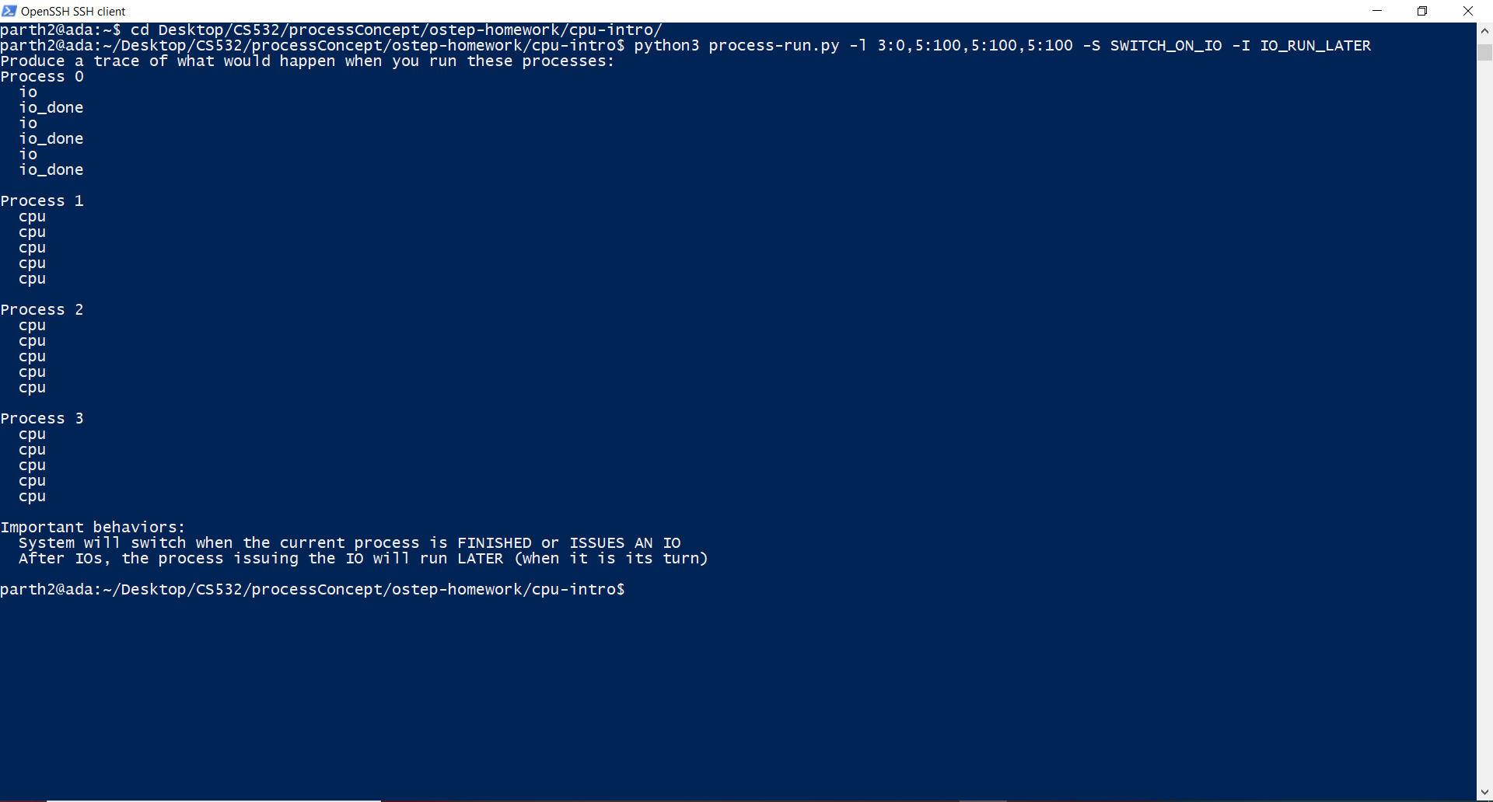

Slide 26
No, the system resources are not being utilised effectively. This can be explained as given below:-
When the process 0 is RUN, then all other processes are in the READY state.
Since Process 0 contains an I/O request instruction, it starts executing the I/O and enters the WAITING state. Consequently, as Process 0 enters the WAITING state, Process 1 enters the RUN state and Process 2 and Process 3 stays in the READY state.
Process 1 executes and is completed.
After Process 1 is completed it enters the DONE state, consequently, Process 2 starts executing while Process 3 stays in the READY state. In the meantime, Process 0 enters the READY state. But since we have explicitly set in the command SWITCH_ON_IO -I IO_RUN_LATER, this means hen an I/O completes, the process that issued it is not necessarily run right away; rather, whatever was running at the time keeps running.
Now, due to this behaviour of the command , Process 2 keeps on executing till it is completed and enters the DONE state.
After Process 2 is completed, Process 3 enters the RUN state because it is next in the Process Queue of the Operating system. Process 0 still remains in the READY state but now moves up in the Process Queue and is next to Process 2.
Process 3 completes its execution, enters the DONE state and then transfers the control to the Process 0 which then enters the RUN state from READY state.
Now, it completes the execution of the first I/O instructions which started in 1).
Process 0 now starts executing the second instruction where it enters another interrupt and goes in the WAITING state, waiting for the second interrupt to be completed.
After completing the second instruction , the signal for second interrupt completion is send by the I/O device and received by the process 0.

Slide 27
11) After that, the third I/O instruction is then executed. Here also, the Process 0 enters the WAITING state, waiting for the I/O to be completed.
12) After the I/O will be completed, all the instructions for Process 0 have been completed and hence the process 0 enters the DONE state.
As can be seen, the time when Process 0 is in WAITING state, all other processes enter the RUNNING state one after the other but the Process 0, since it is given to not Execute right after the I/O is completed, has to wait. This then means that when Process 0 is run at the end, it increases the Run time as well as CPU remains Idle.
Hence, the CPU resources are not being utilised properly in this scenario
This can also be seen in the images in the next slides where the CPU utilisation and I/O utilisation percentages are also given as:- (67.74%) and (48.39%) respectively which can be significantly improved by not keeping I/O in the not execute immediately state.

Slide 28
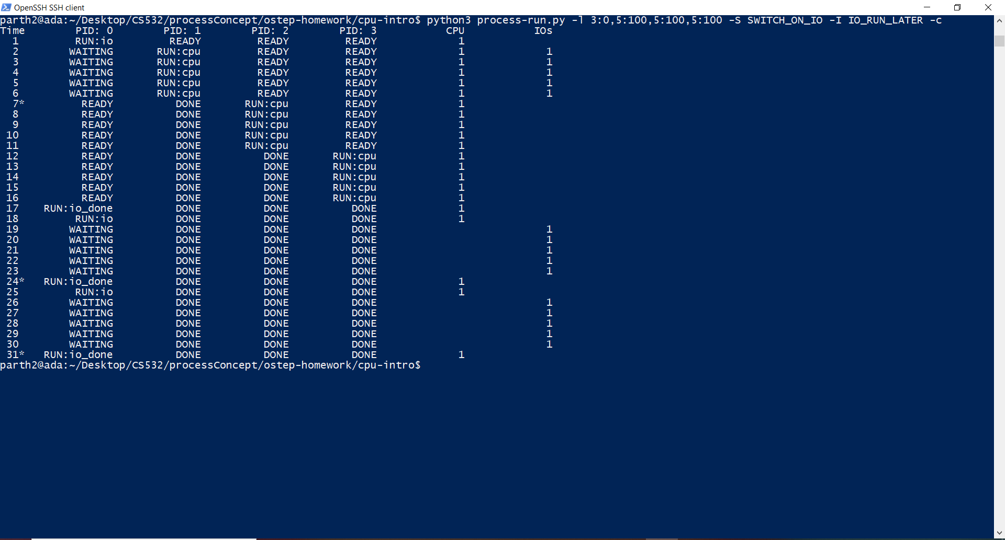

Slide 29
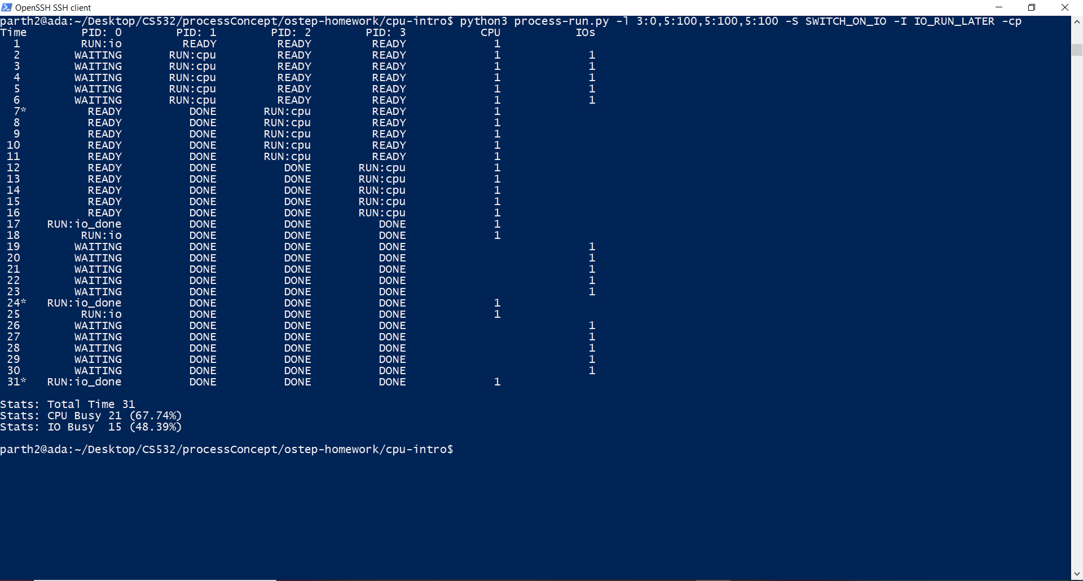

Slide 30
7. Now run the same processes, but with -I IO_RUN_IMMEDIATE set, which immediately runs the process that issued the I/O.
How does this behavior differ?
Why might it be a good idea to immediately run a process that just completed an I/O?

Slide 31
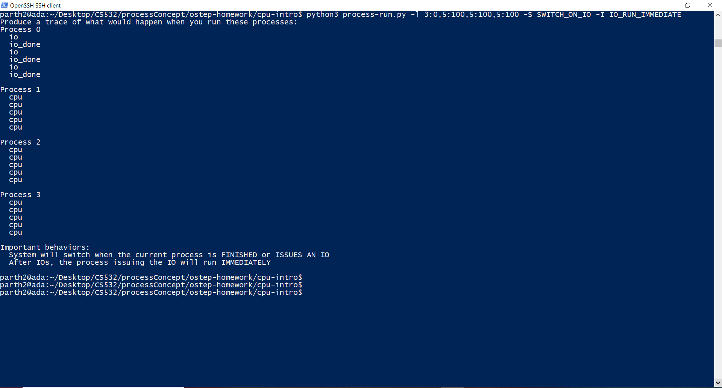

Slide 32
This behaviour differs from the last questions behaviour because here, Process 0 after encountering the instruction containing I/O will run immediately after completing the I/O. It will not have to wait for the other processes (1,2,3) to be completed for being executed.
This behaviour can be explained as below:-
Process 0 starts executing and enters the RUN state. During this time, all other processes are still in the READY state.
Process 0 encounters the first I/O instruction and then enters the WAITING state, waiting for the I/O to be completed.
During this time, Process 1 enters the RUN state from READY state and starts executing, utilizing the CPU Resources. Process 2 and Process 3 still remain in the READY state.
Now, As soon as Process 1 executes completely, Process 0 starts executing again ( because of I/O_run_immediate which immediately runs the process that issued the I/O.) and enters the WAITING state as soon as it reads the second instruction which also contains an I/O interrupt. During this time, Process 1 is in DONE state and Process 2 and Process 3 are in the READY state.
As soon as Process 0 enters the WAITING state, Process 2 enters the RUN state and starts utilising the CPU resources to complete its tasks. Process 3 in the meantime remains in the READY state.
Process 2 completes executing and enters the DONE state. Along with that, Process 0, which by this time has completed its second I/O has entered the RUN state again (IO_RUN_IMMEDIATE)
This time, Process 0 reads it’s third instruction and enters the WAITING state again, waiting for the third I/O instruction to be completed
During this time, Process 3 which was in the READY state all along now enters the RUN state and starts executing its operations.

Slide 33
9) When Process 3 finishes its set of operations, Process 0 (which by this time has completed its I/O operations) enters the RUN state from WAITING state and starts executing. Process 3 enters the DONE state by that time.
10) Process 0 completes its execution and enters the DONE state.
How does this behavior differ?
The difference between I/O_RUN_IMMEDIATE and I/O_RUN_LATER is evident from the fact that I/O_RUN_IMMEDIATE runs the process with I/O immediately it completes the execution of I/O thus saving a lot of precious CPU time as well as increases the overall efficiency of the CPU which is not the case in I/O_RUN_LATER.
Why might it be a good idea to immediately run a process that just completed an I/O?
As can be seen from the explanation above, to utilize the CPU as well as I/O time and resources efficiently, It is a good idea to immediately run a process that just completed an I/O.
This is also evident from the fact that the CPU Utilization in this particular case is 100%.
The screenshots in the next two slides show the Processes, CPU utilization and I/O utilization data as captured from the terminal when the processes were being executed.
It’s also a good idea because a process that performs one I/O often will perform another I/O soon

Slide 34
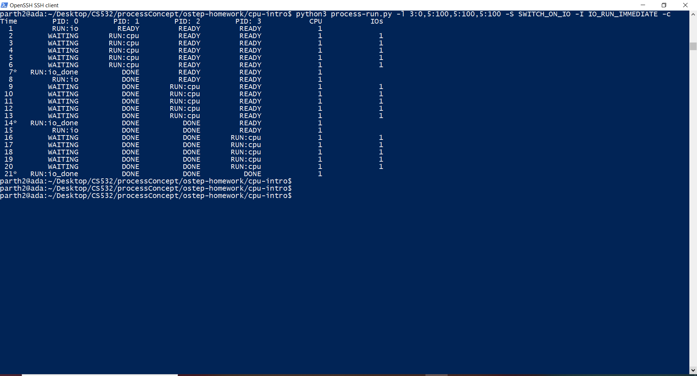

Slide 35
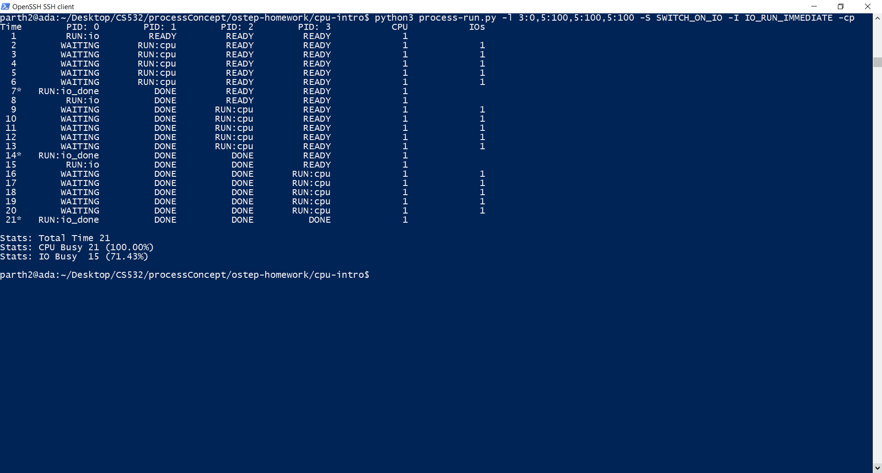

Slide 36
8. Try these randomly generated processes (and additional scenarios chosen by you):
-s 1 -l 3:50,3:50
-s 2 -l 3:50,3:50
-s 3 -l 3:50,3:50
Try each with -I IO_RUN_IMMEDIATE and -I IO_RUN_LATER
Try each with -S SWITCH_ON_IO and -S SWITCH_ON_END
No need to report anything for #8. Your goal is to develop intuition and understanding of why the system schedules processes in various scenarios.

Slide 37
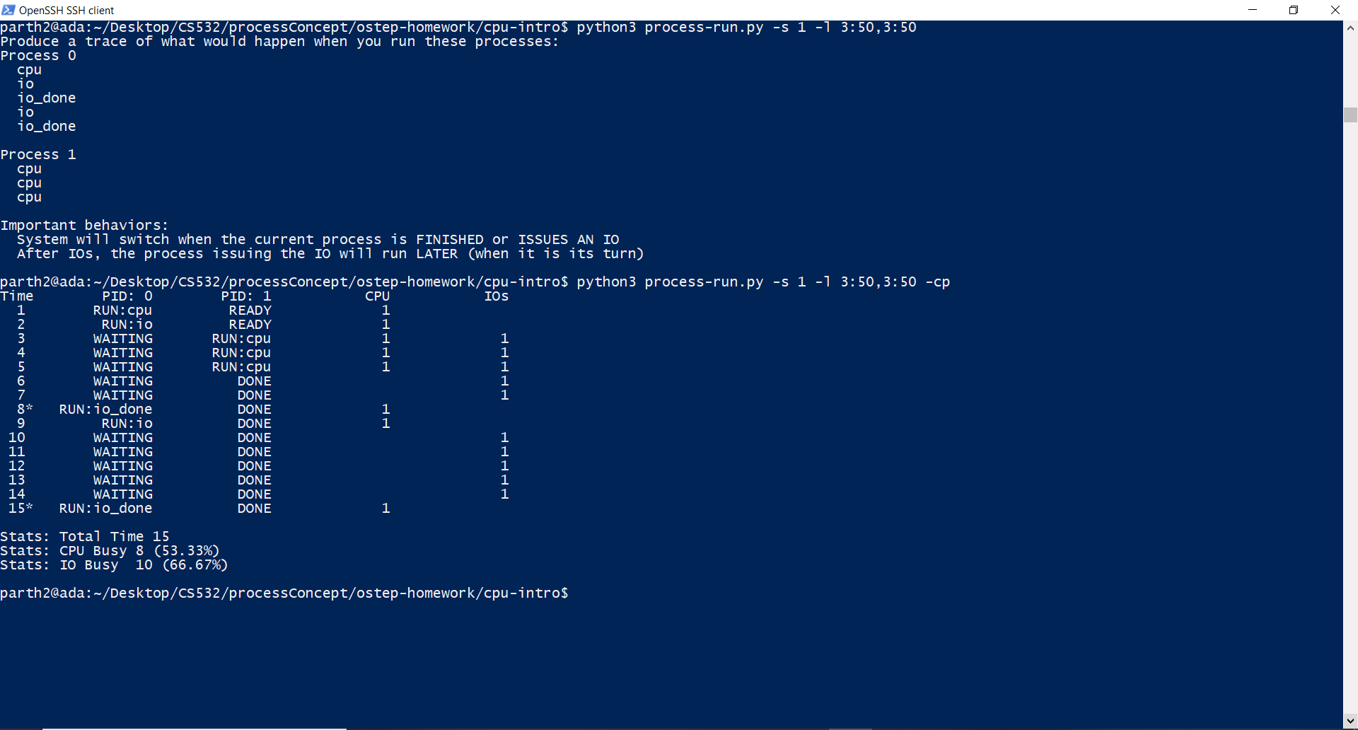
-s 1 -l 3:50,3:50

Slide 38
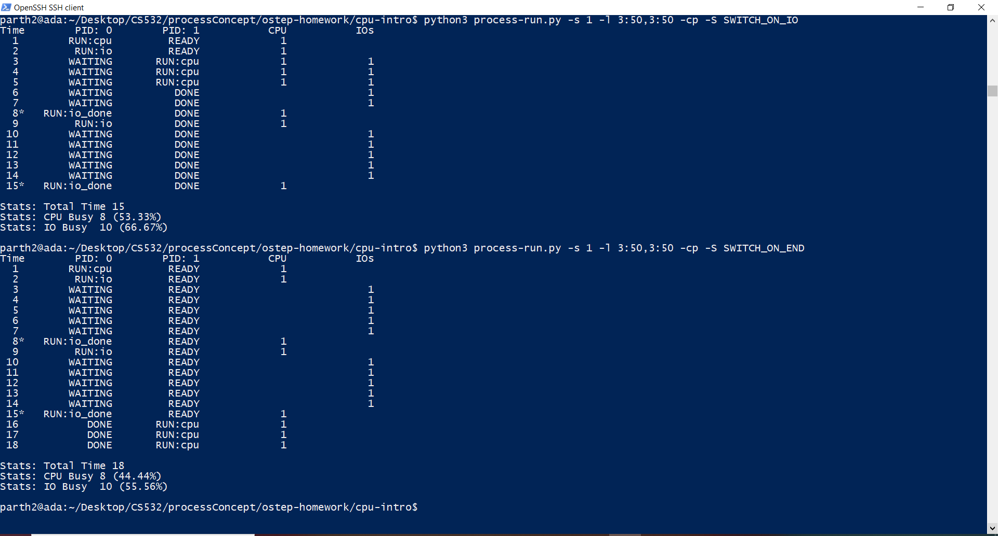

Slide 39
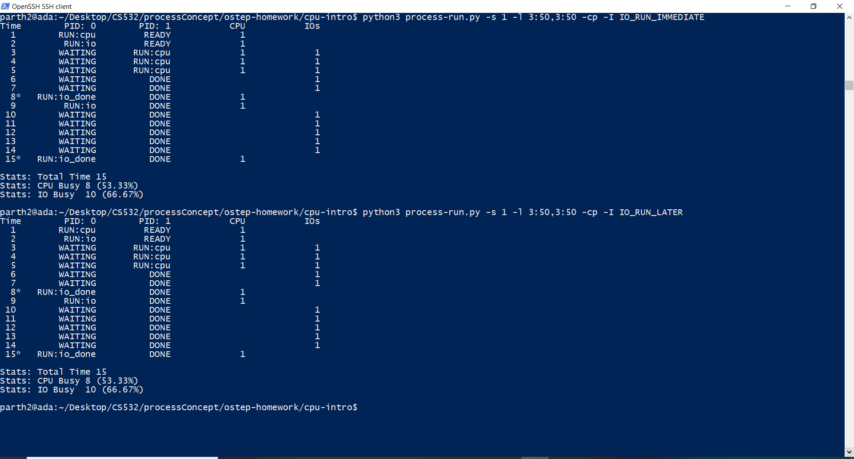

Slide 40
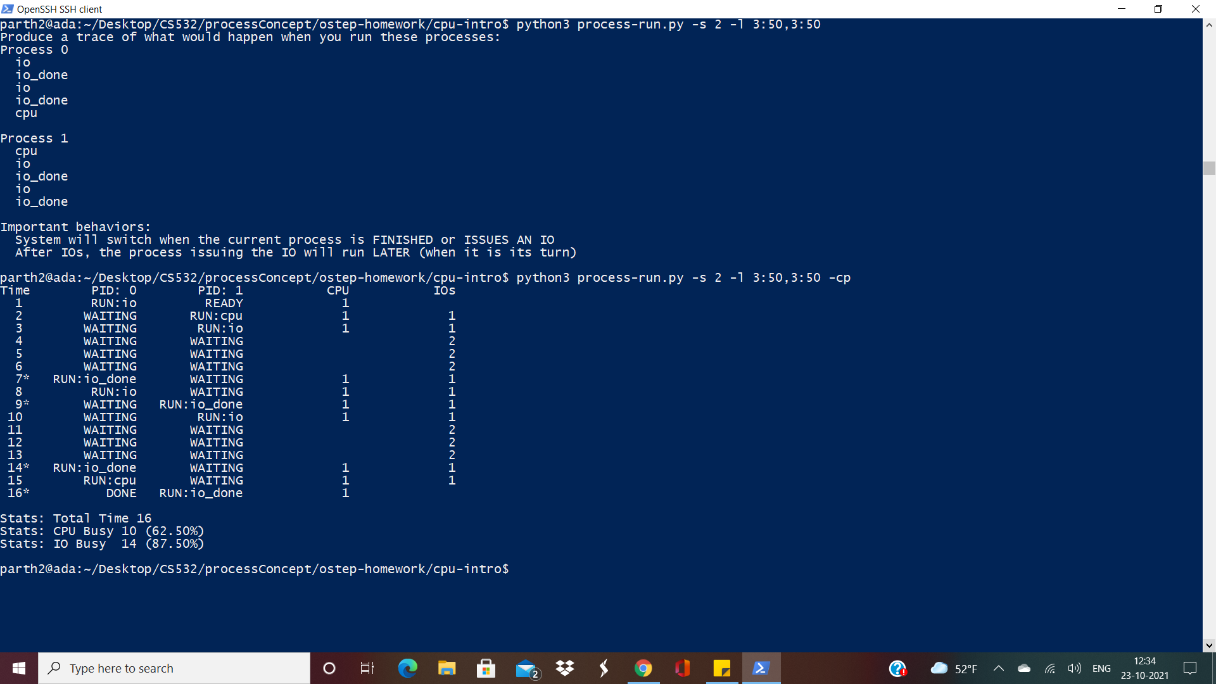
-s 2 -l 3:50,3:50

Slide 41
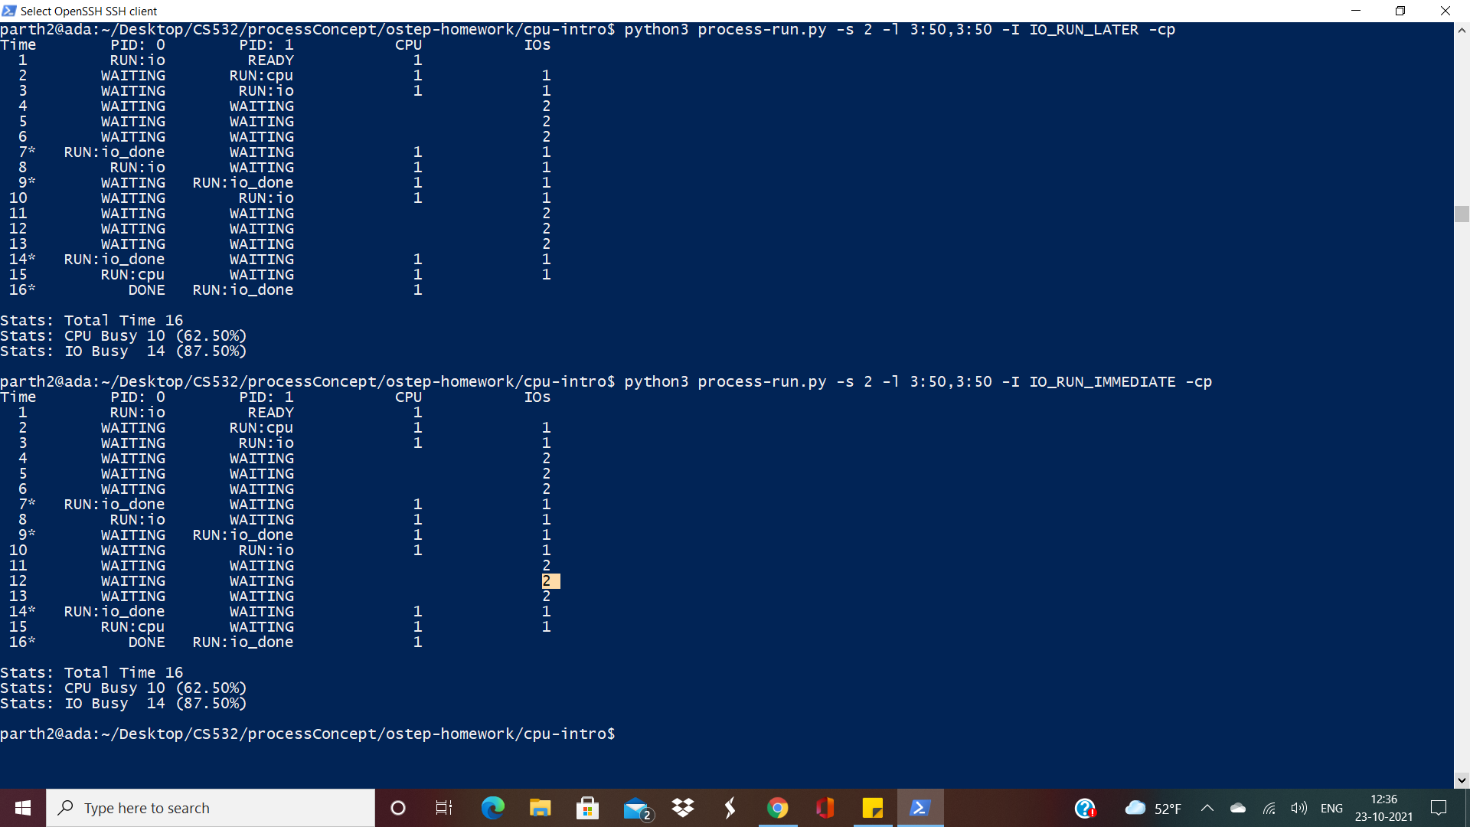

Slide 42
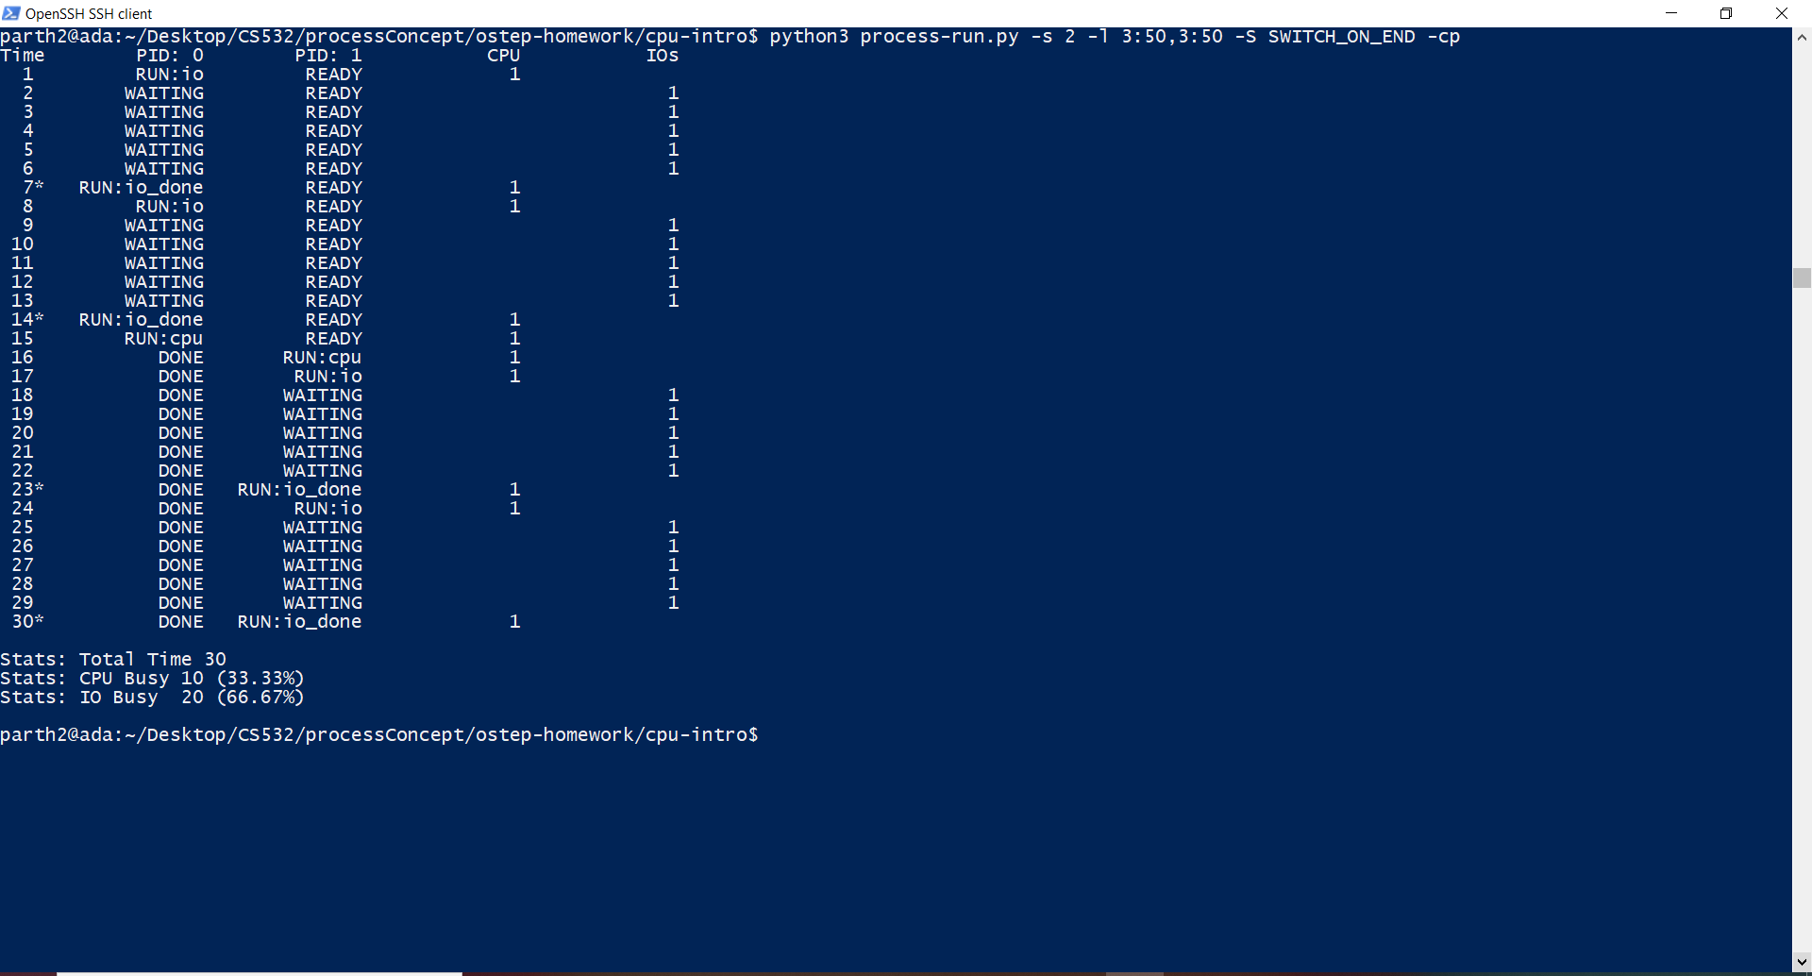

Slide 43
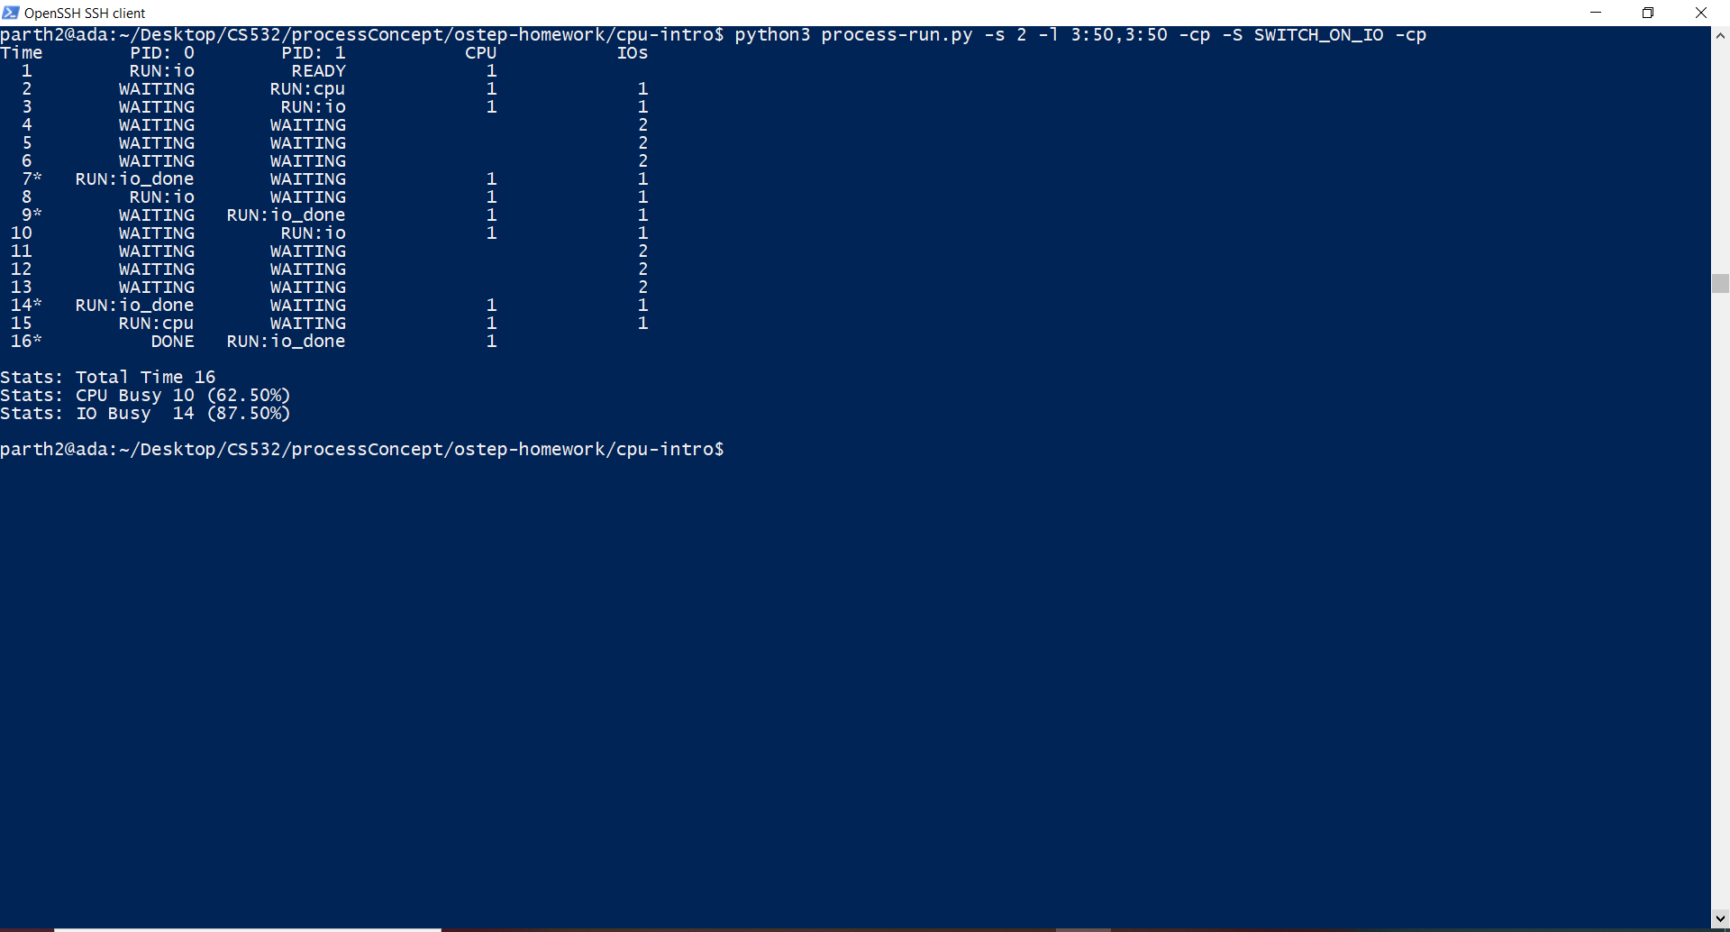

Slide 44
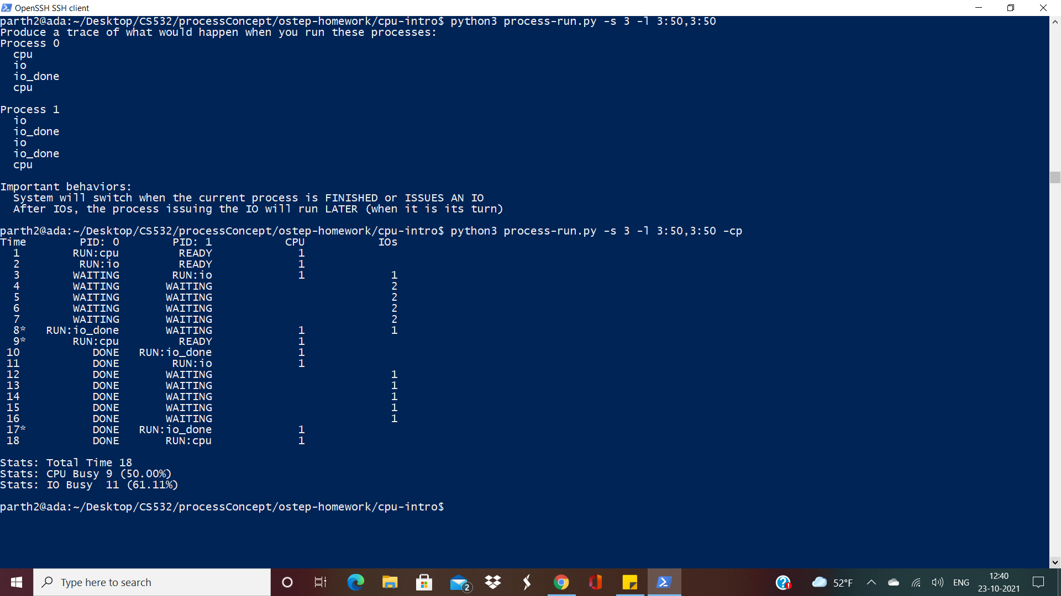
-s 3 -l 3:50,3:50

Slide 45
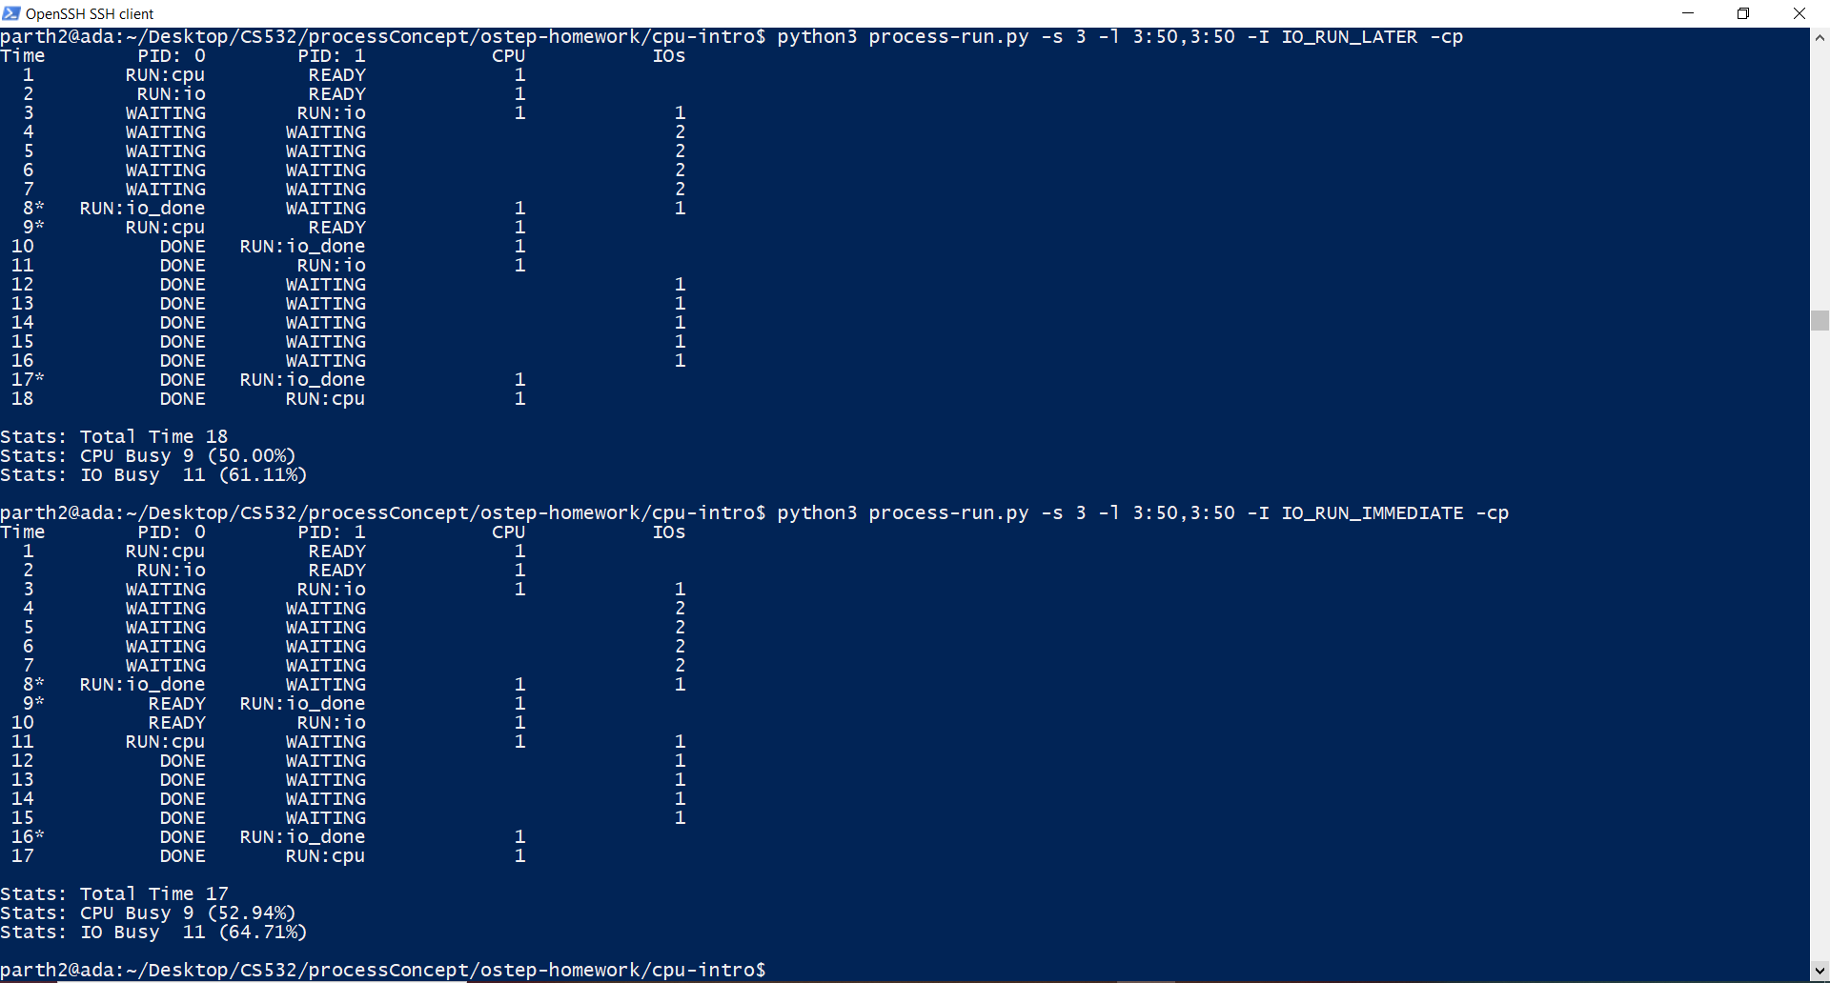

Slide 46
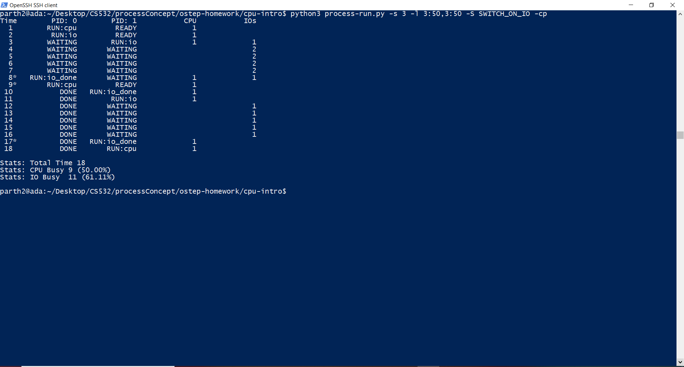

Slide 47
